Slide 1
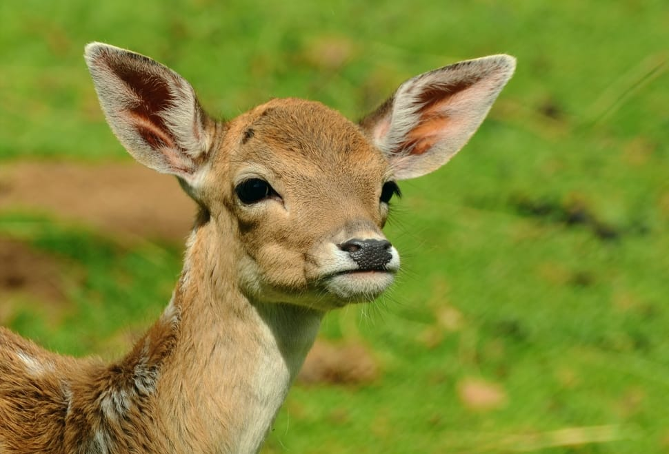
Blinkers on the NAM
This deer is a paid actor
Image source: https://www.pexels.com/photo/deer-in-grass-field-during-day-time-144250/

Slide 2

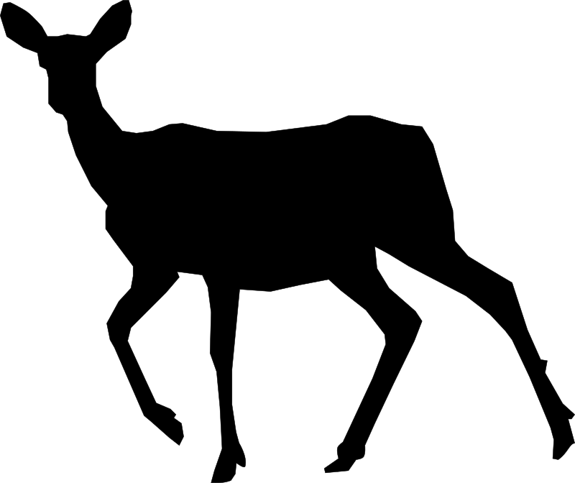
Introduction
Thesis:
~How to broaden NAM’s perspective and inclusivity on an individual to global scale of wildlife management.~
Topic:
Blinkers on the NAM: What perspectives have been left out of the North American Model?
“North America” includes the U.S., and Canada. But, technically it is a European-based approach (colonization), and true (Native) Americans are not fairly represented. Natives have traditional values, culture, that they stringently abide by when dealing with wildlife - Holistic approach.
Important Question of Focus:
How might this narrow view of management be addressed and improved?
Involve non-invasive wildlife enjoyers like bird-watchers, Indigenous Peoples, expand to an individual-global gradient of perspectives.
“Geist & Mahoney arrived at what they described as ‘the North American Model of Wildlife Conservation’: a set of principles and a historical narrative that has defined what constitutes and incentivizes legitimate and ethical use of wildlife in the United States and Canada” (“Fair Chase Colonialism” 2020).
“The denial of Indigenous peoples’ ability to cultivate ecosystems through hunting, foraging, and fire stewardship under settler-colonial governance has fractured time-tested socioecological relationships and resulted in severe environmental mismanagement”
- (“Fair Chase Colonialism” 2020).
Source: Fair Chase Colonialism: An Environmental Justice Critique of the North American Model of Wildlife Conservation (Pt 2). 2020, December 12. .
Notes:
First Bullet: But technically *the model* is..
Second bullet: indiv-global means there are many people NOW in America from all over the world and back when the NAM was created, it wasn’t as diverse. A lot of attitudes were different as well. Melting Pot.

Slide 3
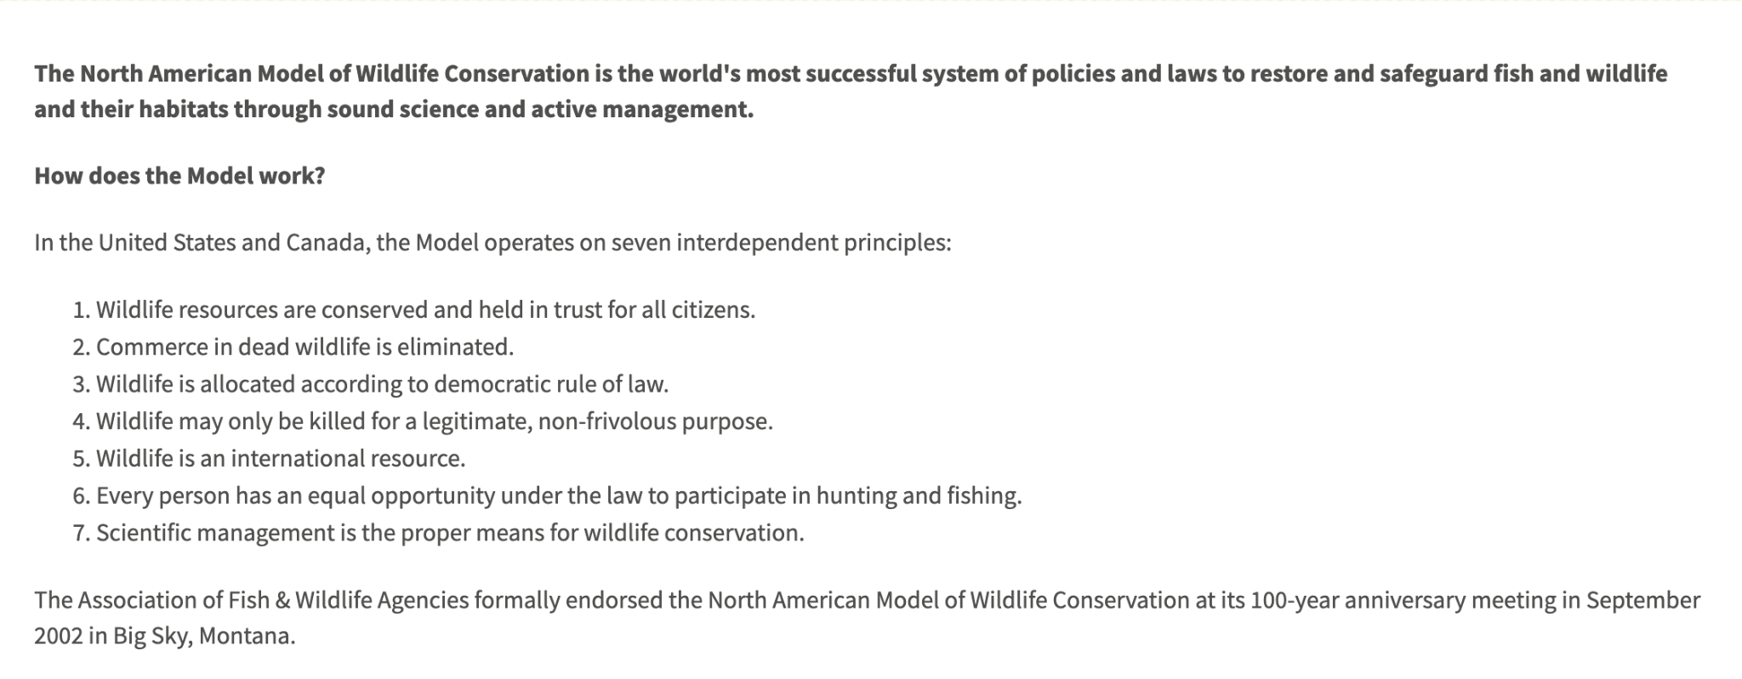
Little Refresh:
Source: https://www.fishwildlife.org/landing/north-american-model-wildlife-conservation

Slide 4
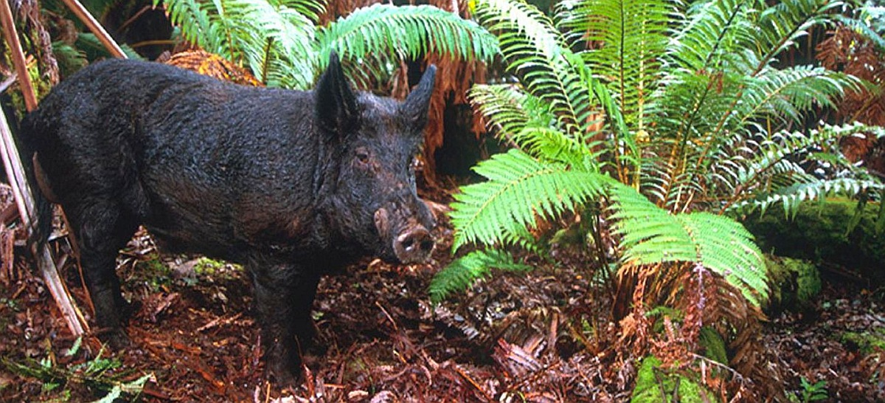
Cultural Perspective
Feral pigs in Hawaii
Research by Nate Wehr
Pigs = BAD for the environment
BUT indigenous people hunt them and value them culturally
Goal:
“Strike a balance between the indigenous and non-indigenous perspectives” - Nate
Account for the cultural impacts that managing wildlife may incur
Management plans to consider different cultures that implement other hunting practices (Smith et. al 2016)
The social license to hunt model (SLH) considers changing societal values immediate influence on policy change
The results encourage current policy to reach the broader public so they may better consider how their wildlife is being represented and managed (i.e. trophy hunts) in terms of short or long term policy change in a dynamic society
(Darimont et al 2020)
Image source: https://www.fws.gov/media/feral-swine-hawaii
Notes:
“...the results of my research on feral pigs in Hawaii was largely indicative of how bad feral pigs are for the environment. However, the native Hawaiians have a cultural connection to the feral pigs and value them as a game species. Therefore, my recommendation to managers was not to entirely eradicate the pigs even though this would provide the greatest benefit to the environment and to non-indigenous peoples. Instead, I suggested eradicating the pigs only in select areas with rare species and in areas that were difficult for pig hunters to access to try and strike a balance between the indigenous and non-indigenous perspectives.”

Slide 5
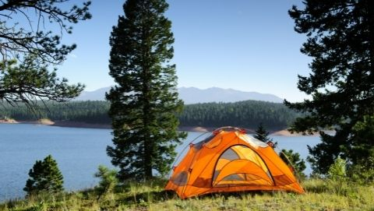
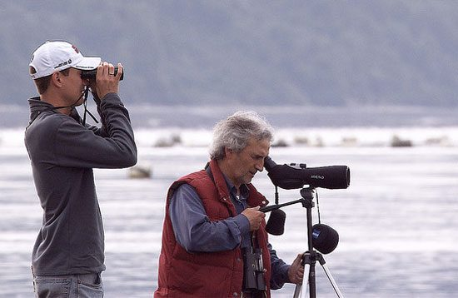
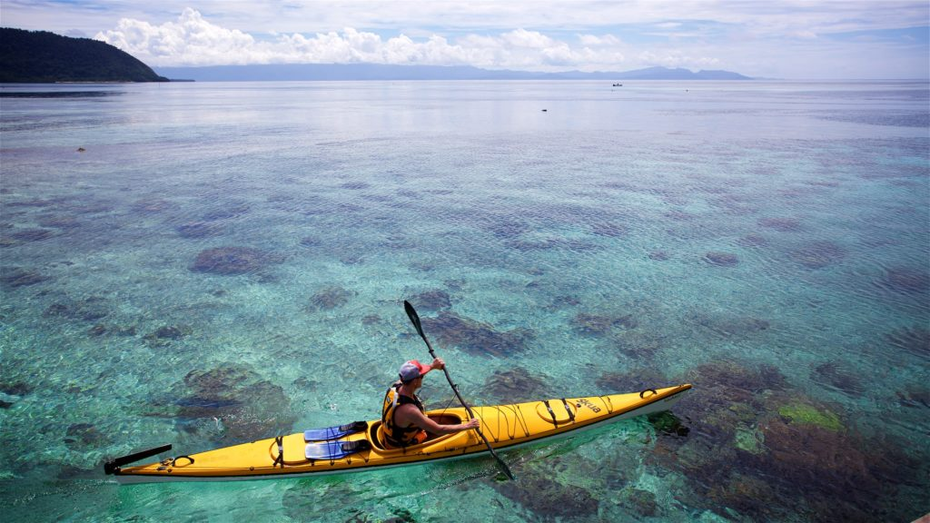
Social/Economic Perspective
Non-hunter view : “Enshrining” hunting as a basis of conservation (Mahoney & Jackson 2013)
NAM lacks to include other participants of environment in their management:
Bird watchers
Eco-tourism drive:
Exploring new places & landscapes, observing rare and endemic species & charismatic megafauna
“One of the most practical ways to do this would be to implement taxation on equipment that is exclusively used for outdoor recreation such as binoculars, tents, etc.
Some other ways to do this would be to require folks to purchase hiking passes or something else that would give them access to the same areas hunters often use.
That being said, I think it's important that we keep outdoor activities accessible to folks from all economic classes, and I think a more nuanced approach will be necessary to truly 'solve' this.”
Insufficient funding is a leading drawback to proper conservation efforts. (Larson et al 2021)
-Nate Wehr (Community Ecologist)
Image sources:
https://www.allaboutbirds.org/news/binoculars-and-beyond-nine-tips-for-beginning-bird-watchers/ (bird watching)
https://scandasia.com/great-places-for-sea-kayaking-in-southeast-asia/ (kayaking) https://extension.usu.edu/healthwellness/physical/the-physical-benefits-of-camping (camping)
Notes:
The current standing “user-pay, public benefit” model withstanding US conservation faces collapse as numbers of participating hunters decrease. A study asking college students found need to broaden the support of conservation funding and consider the ideas and interests of the upcoming generation

Slide 6
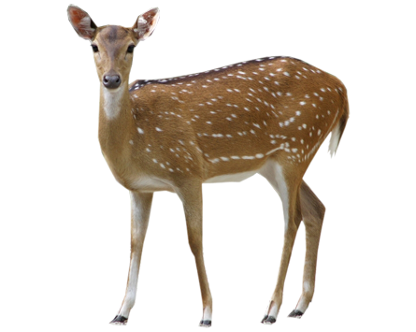

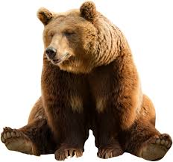
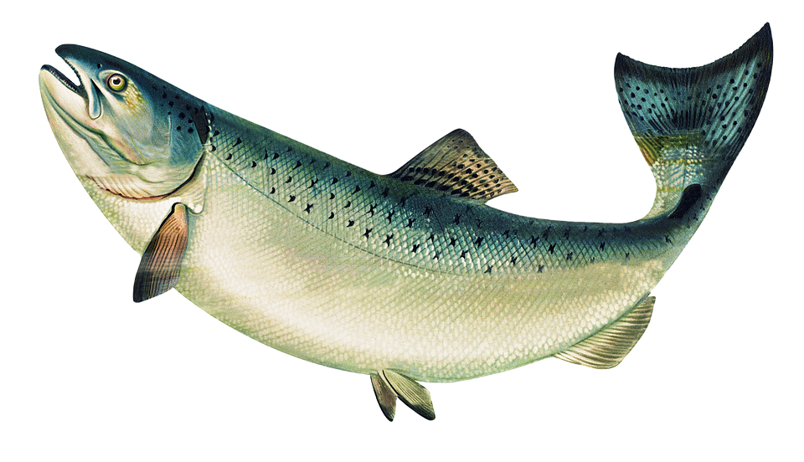
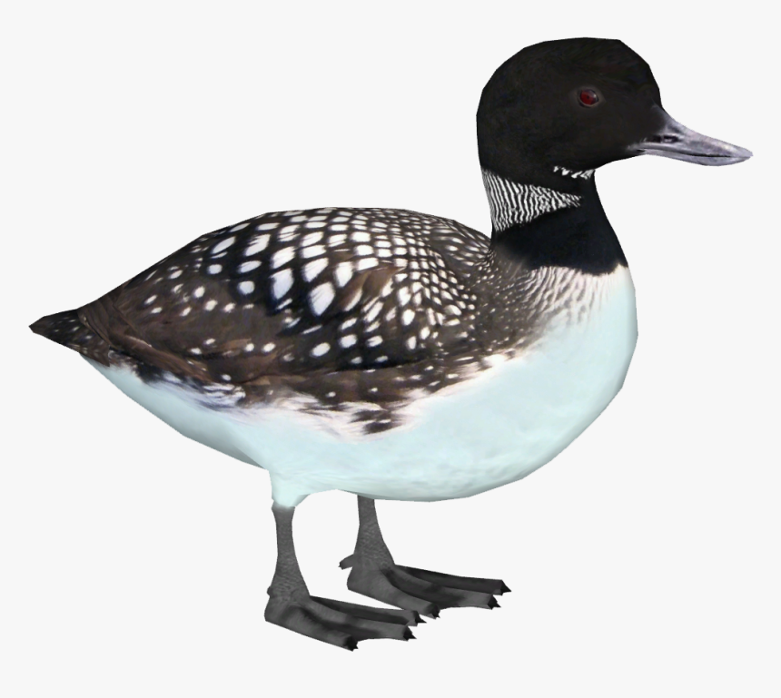
Political Perspective
Wildlife are currently independently managed as a species,
rather than fit within the larger context of their ecosystems and interactions.
“ By focusing on a handful of important game species, we may be taking away funding or other resources from conservation efforts that could benefit non-game species. However, game species often require large tracts of land to support them, and these large tracts can indirectly benefit non-game species.”
Nate Wehr (Community Ecologist)
Diction of the doctrine manifests further anthropocentric aspects as objectifying hunted animals as a resource to extract (Eichler & Baumeister, 2018)
Image sources: http://clipart-library.com/free/deer-transparent-background.html ; https://www.pngmart.com/image/350160

Slide 7
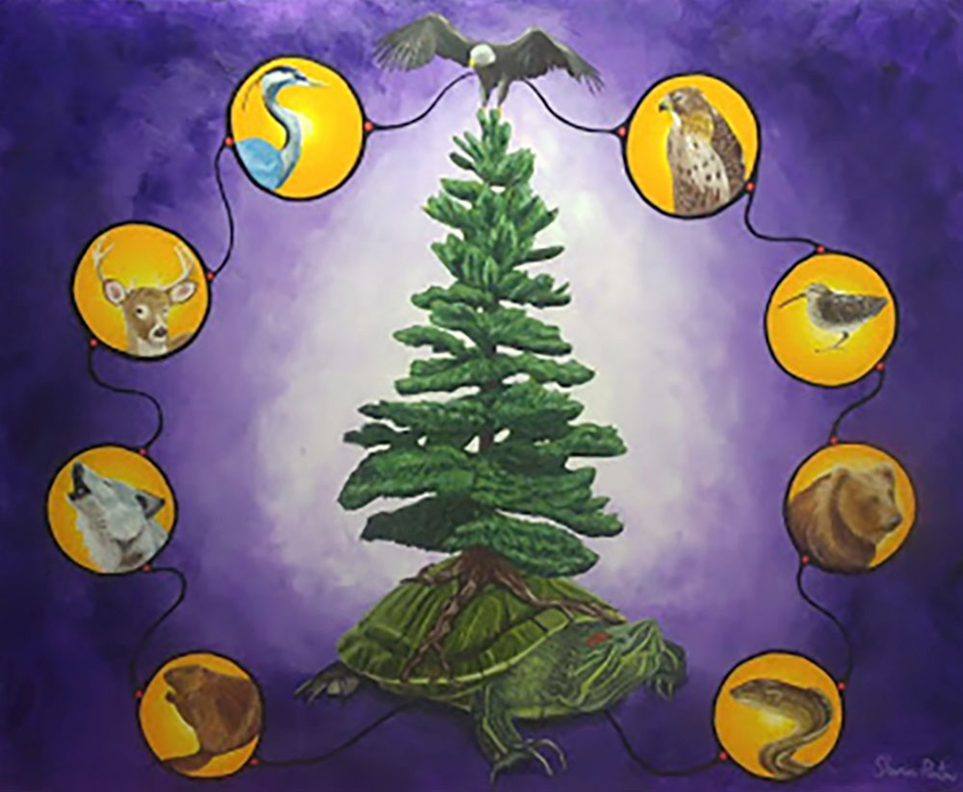
Indigenous-led stewardship is an example of
what wildlife management could be
“...this agreement (CITES) and others are often very messy and far more politically-driven than what would best benefit wildlife.”
-Nate Wehr (Community Ecologist)
Considering their grounded values towards:
Being inspired by a intimate relationship to wildlife & their habitats
Informed by knowledge and values derived from long history of that relationship
Complemented by new advancing science
Overseen by individuals who live in the area and bare the consequences of management directly
Individuals who uphold that their decisions impact their, and the world’s children, and their children’s children
(Artelle 2019)
Image source: https://www.haudenosauneeconfederacy.com/

Slide 8
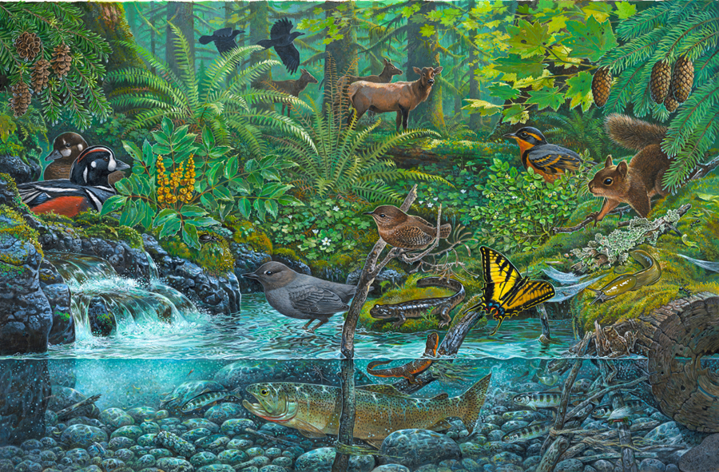
We propose a New Tenet:
Wildlife should not be viewed as resources,
but as valued assets to social, political, cultural and economic systems
Neil Patterson introduced the idea of a bi-focal view on how we observe the environment
Why stop there?
Image source: John D Dawson Art https://ferrebeekeeper.wordpress.com/tag/john-d-dawson/
Notes:
provides in some ways a best-case example of what wildlife management can be: inspired by a close relationship to wildlife and their habitats, informed by knowledge and values borne of the deep history of that relationship, complemented by cutting-edge science, and led by people who not only live in the area but also shoulder the consequences of management directly--well aware that their decisions will determine the world that their children and their children's children will inherit.

Slide 9
Literature Cited:
Artelle, K. A. 2019. Is Wildlife Conservation Policy Based in Science? American Scientist 107:38–46. https://go.gale.com/ps/i.do?id=GALE%7CA579092378&sid=googleScholar&v=2.1&it=r&linkaccess=abs&issn=00030996&p=AONE&sw=w&userGroupName=nysl_ca_ind
Cooney, J. M. 2020. Fair Chase Colonialism: An Environmental Justice Critique of the North American Model of Wildlife Conservation (Pt 2). 2020, December 12.
https://jaymcooney.wordpress.com/2020/12/12/fair-chase-colonialism-part-2/
Darimont, C. T., H. Hall, L. Eckert, I. Mihalik, K. Artelle, A. Treves, and P. C. Paquet. 2021. Large carnivore hunting and the social license to hunt. Conservation Biology 35:1111–1119. https://conbio.onlinelibrary.wiley.com/doi/full/10.1111/cobi.13657
Larson, L. R. et. al. 2021. The future of wildlife conservation funding: What options do U.S. college students support? Conservation Science and Practice 3:e505.
https://conbio.onlinelibrary.wiley.com/doi/full/10.1111/csp2.505
Smith, D. W., P. J. White, D. R. Stahler, A. Wydeven, and D. E. Hallac. 2016. Managing wolves in the Yellowstone area: Balancing goals across jurisdictional boundaries. Wildlife Society Bulletin 40:436–445. https://wildlife.onlinelibrary.wiley.com/doi/full/10.1002/wsb.677
Eichler, L., and D. Baumeister. 2018. Hunting for Justice: An Indigenous Critique of the North American Model of Wildlife Conservation. Environment and Society 9:75+.
https://go-gale-com.esf.idm.oclc.org/ps/i.do?p=GRNR&u=sunycesfsc&id=GALE%7CA557313051&v=2.1&it=r
Mahoney, S. P., and J. J. Jackson. 2013. Enshrining hunting as a foundation for conservation – the North American Model. International Journal of Environmental Studies 70:448–459. https://www.tandfonline.com/doi/full/10.1080/00207233.2013.801178?casa_token=6S-E7DzDZ7AAAAAA%3AmWkzADqMyqHXWBIjDB4N9x9em_FFwG10pcvo9Bkl88EjdTuGf4mJU6oYUbNLcabQizvkvJMunYELAA

